Slide 1


Digital Marketing Campaign Performance Report
Analysis of 8,000 customers — cleaned, queried in SQL, and visualized in Power BI.

Slide 2
Campaign at a Glance
8K
7,012
Customers Analyzed
Successful Conversions
87.65%
$5,001
Overall Conversion Rate
Avg Ad Spend / Customer
15.48%
7.73
Avg Click-Through Rate
Avg Minutes on Site

Slide 3
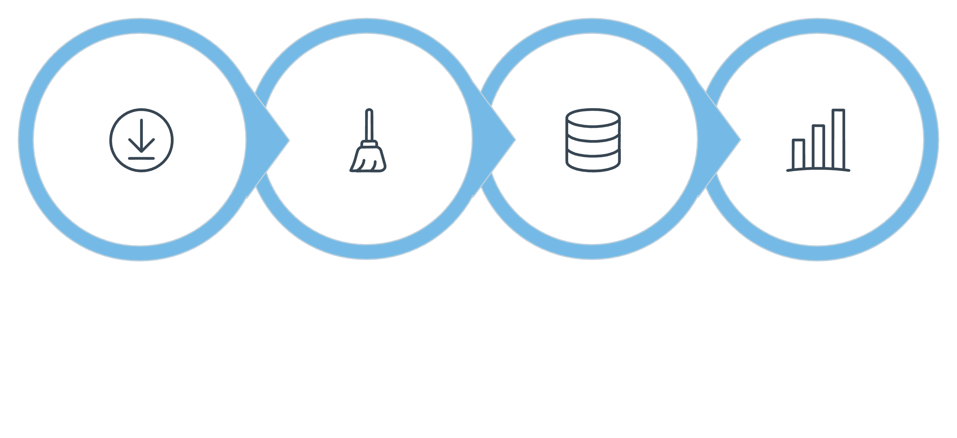
4-Step Project Workflow
Data Collection
Cleaning & Formatting
Database & SQL
Visual Dashboard

Slide 4

Audience & Demographics
Gender
Age
Female 87.62% · Male 87.69% — nearly identical rates
32–43 leads at 87.93%; all groups range 87.35%–87.93%
Income
High 88.15% · Medium 87.51% · Low 87.29%

Slide 5
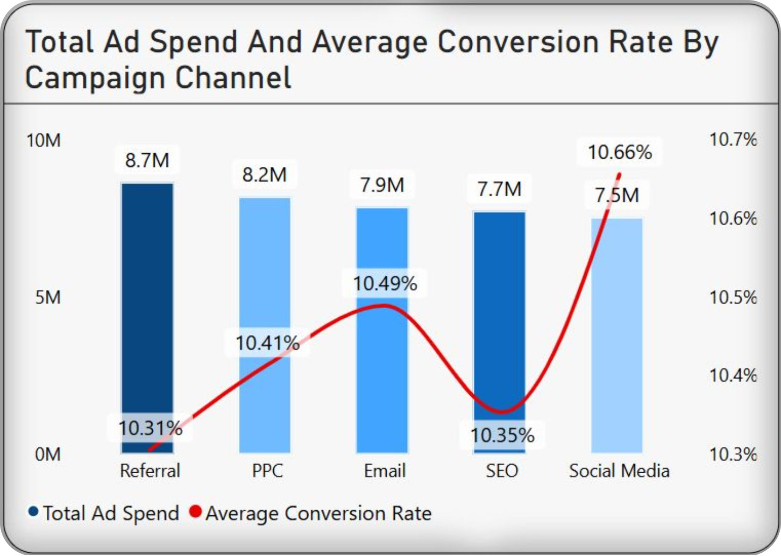
Channel Performance
Top Channels
Referral (88.31%) and PPC (88.28%) lead conversion rates.
Budget Efficiency
Social Media and Email operate on lower ad spend while outperforming baseline expectations — prime scaling opportunities.

Slide 6
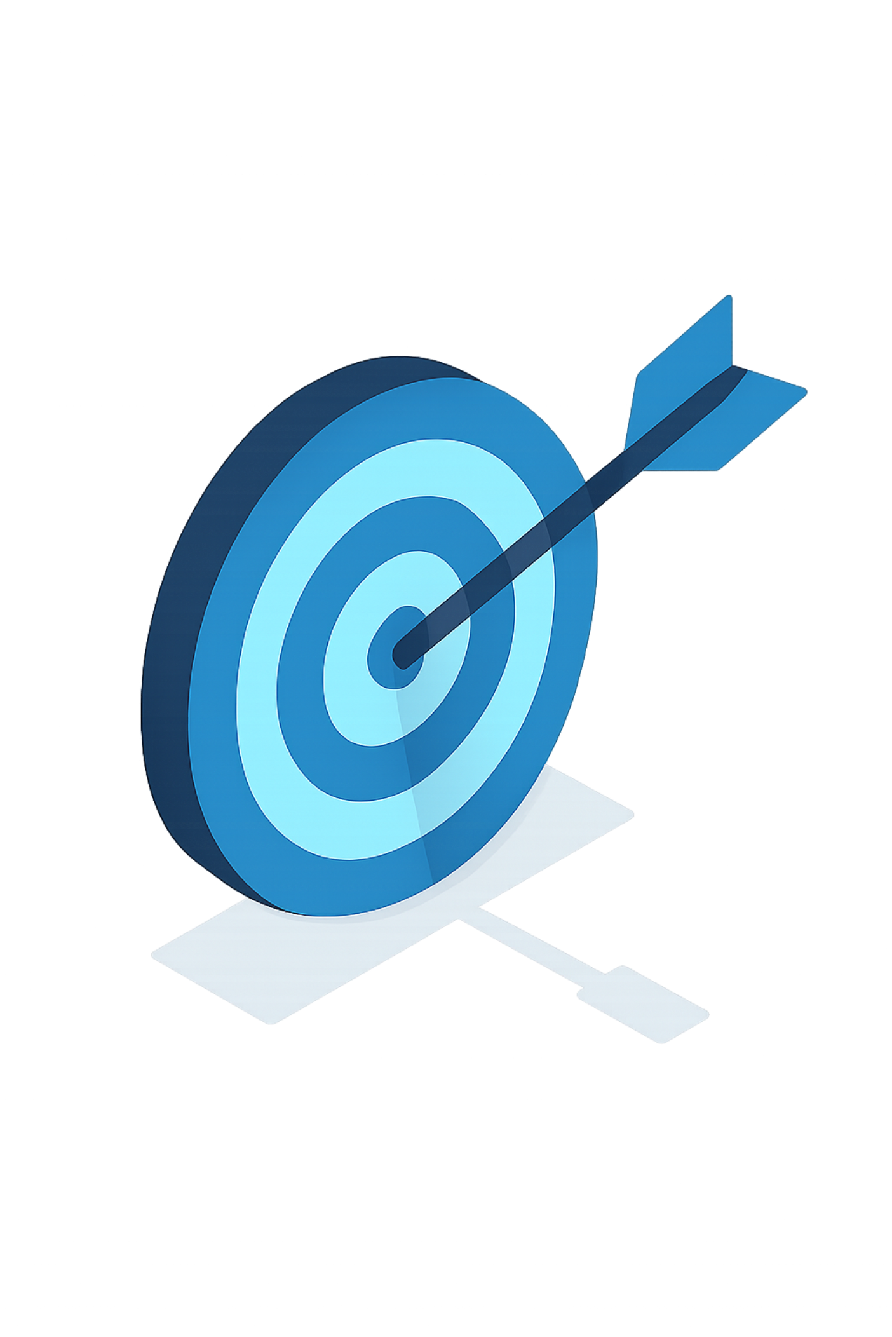
Campaign Type: Conversion Wins
Conversion Campaigns
93.36% rate · $5,312 cost/conversion
Awareness / Consideration
~85.56% rate — significantly lower

Slide 7



Behavior Signals That Predict Conversion
Site Time
Email Clicks
Purchase History
Converters spent +26.5% more time — 7.93 vs. 6.27 min
Converters averaged +32.5% more — 4.61 vs. 3.48 clicks
Converters had +27.0% more prior purchases — 4.61 avg

Slide 8
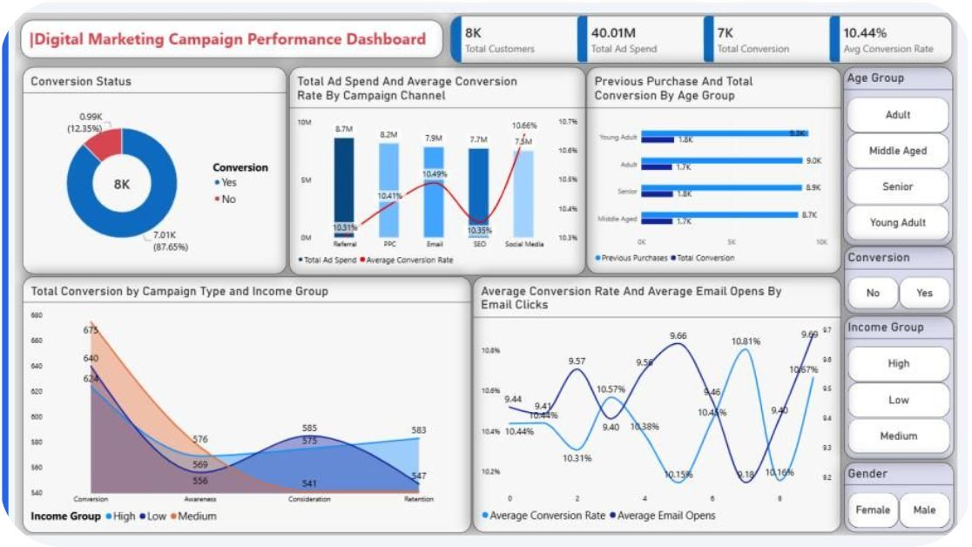
Power BI Dashboard
Interactive Filters
Age Group, Gender, Income
Conversion Status
Visualizations
Conversion by channel & campaign type
Ad spend vs. conversion rate
Email engagement trends

Slide 9
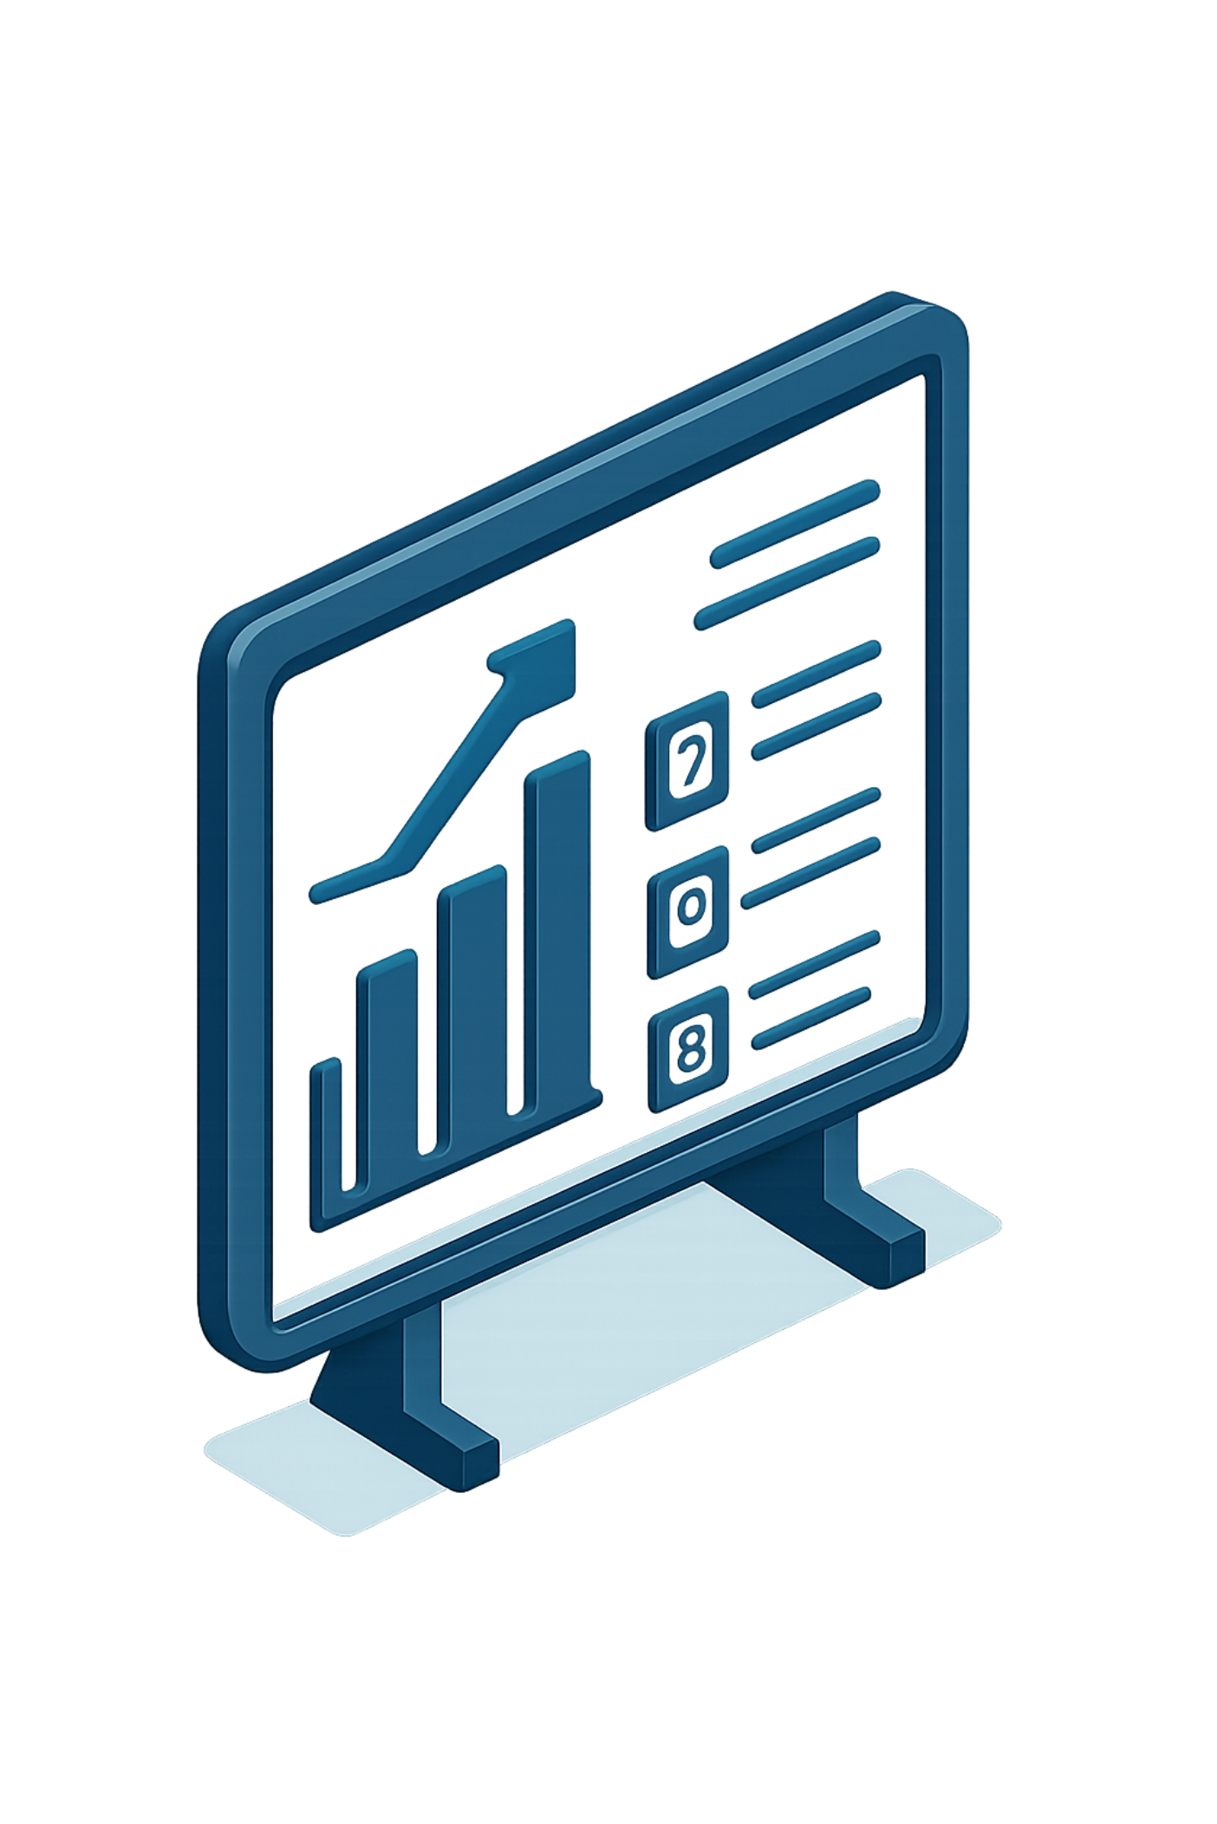

Key Recommendations
Double Down on Conversion Campaigns
Highest ROI, lowest cost per conversion
Scale Email & Social Media
Cost-efficient, outperform baseline
Retarget Engaged Users
Past buyers + high site time = high intent

Slide 10

Summary
8K Customers
Top Channels
87.65% conversion rate
Referral & PPC lead
Best Campaign
Action
Conversion type: 93.36%
Scale Email & Social, retarget
Data cleaned, queried in SQL, and visualized in Power BI.

